Slide 1
How to navigate this Interactive PowerPoint Presentation
This presentation is designed to be an interactive space while providing information.
Whenever you see a Color ringed box, it means you can click or select
an interaction within the presentation.
Click Here to Continue
Click or Select Here
Alternatively, you can also hit the [ENTER] or the [arrow keys] on your keyboard to navigate through animations.

Slide 2
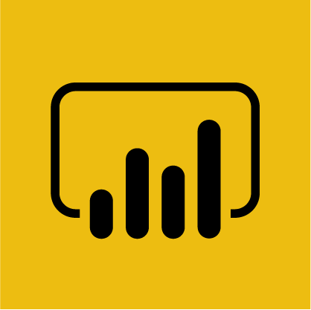
How does Power BI work with Africa Borderlands Centre?
Africa Borderlands Centre
Here is an overview of the pages in this module.
Select any of the boxes below to navigate directly to that page or Continue to begin.
What is Power BI?
How Does Power BI Visualize Data?
How Do you Connect to the data in Power BI?
Continue
Modelling the Data
Relationships
Database Schema Map
Drill Down Visualization
Dashboard Navigation
Questions? Contact Us

Slide 3
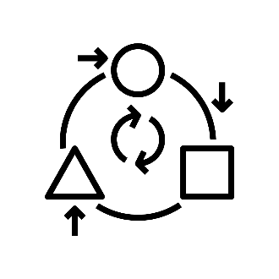
What does Power BI do?
Africa Borderlands Centre
Power BI is a business analytics service that delivers insights to enable fast, informed decisions.
Transform data into stunning visuals and share them with colleagues on any device.
Visually explore and analyze data—on-premises and in the cloud—all in one view.
Continue
Collaborate on and share customized dashboards and interactive reports.
Scale across your organization with built-in governance and security.

Slide 4
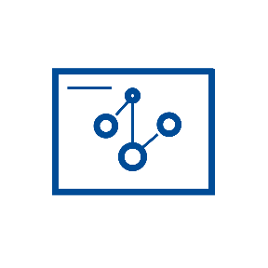
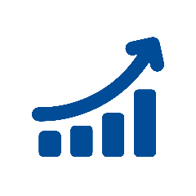
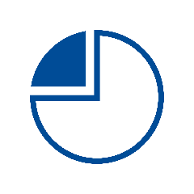
Visualizations of Data
Africa Borderlands Centre
How does visualizing data help users?
Visualizations allow data to be represented in different ways, leading to insights into data relationships that may not be easily seen.
Continue
Power BI allows users to create and adjust visualizations based on their own needs as they look at data.
Users will be able to look at data from different perspectives and find insights into data relationships that help them make better informed decisions.

Slide 5
How Do you Connect to the data in Power BI?
Africa Borderlands Centre
Continue
Continue
This module will provide an overview on how Africa Borderlands is working to support the implementation of Power BI by providing data, reports, and trainings.

Slide 6
How to connect to data sources in Power Bi?
Africa Borderlands Centre
Power BI is a business analytics service that delivers insights to enable fast, informed decisions.
\
Continue
Click on Get Data

Slide 7
Connect to MY SQL as Power BI Data Source
Africa Borderlands Centre
Continue

Slide 8
Enter Server & Database Details
Africa Borderlands Centre
Continue

Slide 9
Enter Database Credentials
Africa Borderlands Centre
Continue

Slide 10
Tables to Select
Africa Borderlands Centre
For the Africa Borderlands Data, select the tables below :
Borders – Holds border pair information. Border Indicators – Holds the Border Indicator Details Border Meta – Holds information on borders like Border Age, Establish Year and Length. Country – Holds information on Country Name. Factsheet – Aggregated data.
Municipality - Holds information on the Districts in each border pairs/country.
Continue

Slide 11
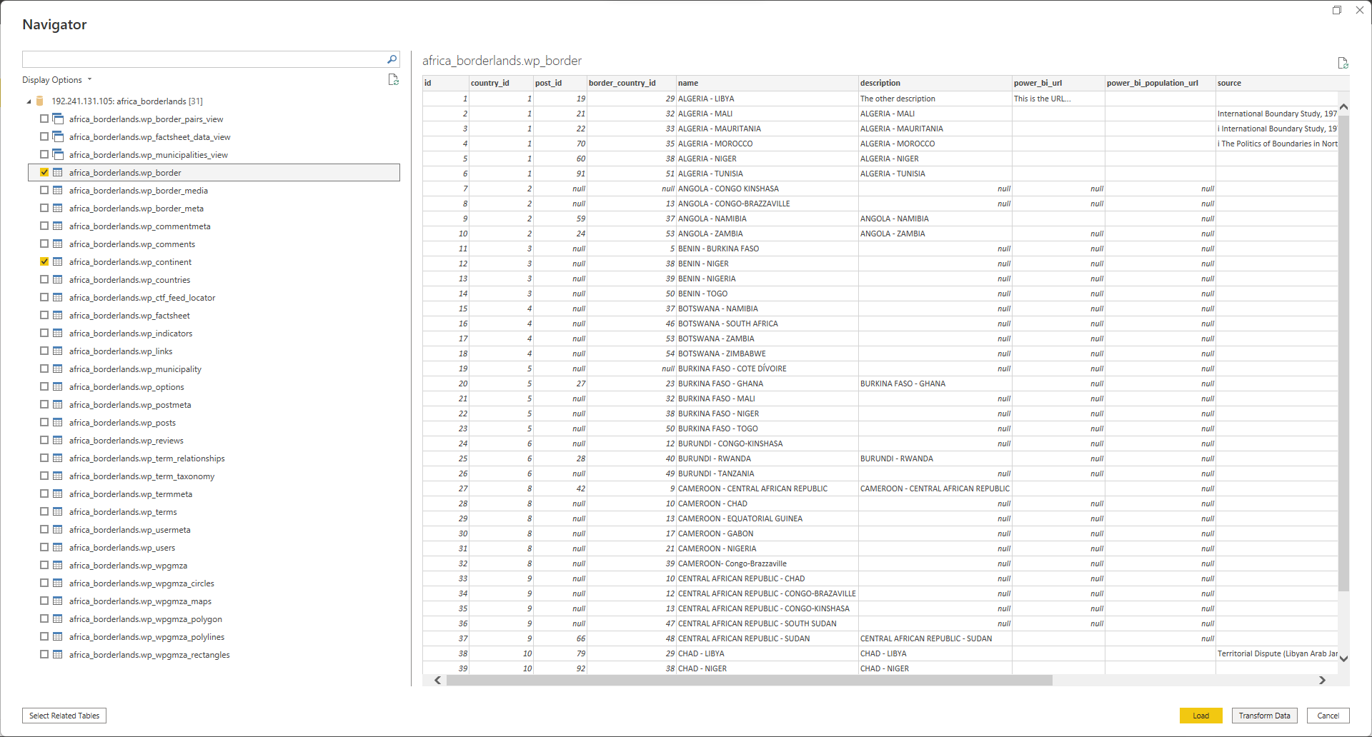
Select the tables you need and Load the data
Africa Borderlands Centre
Continue

Slide 12
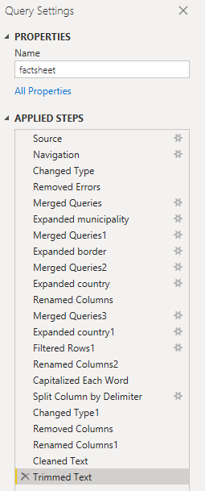
Modelling the Data
Africa Borderlands Centre
We worked on the factsheet mostly as it has the most granular data.
We started off by removing any errors in the data.
Merged fact sheet tables and pulled Municipality Name and Country Name to show countries that each Municipality is in.
Measures to define Metrics of Border Indicators e.g Number of Schools, Number of Hospitals, Police Station & Hospitals to Population ratio.
Measure to dynamically rate Border Pairs by Rank of Indicators.
Multi Border Pair Comparison Visual.
Continue

Slide 13
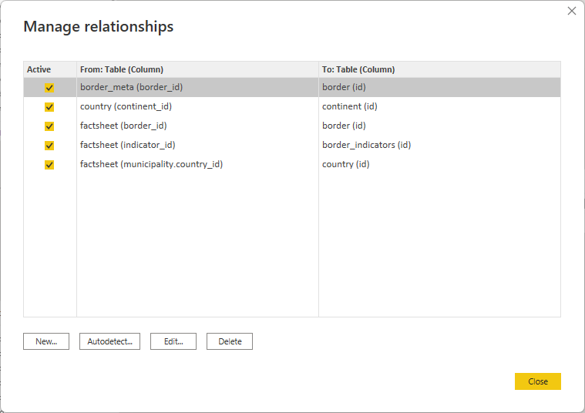
Relationships used to Map the data
Africa Borderlands Centre
From Table Column | To Table (Column)
border_meta(border_id) | border(id)
country(continent_id) | continent(id)
factsheet(border_id) | border(id)
factsheet(indicator_id) | border_indicators(id)
factsheet(municipality.country_id) | country(id)
Continue

Slide 14
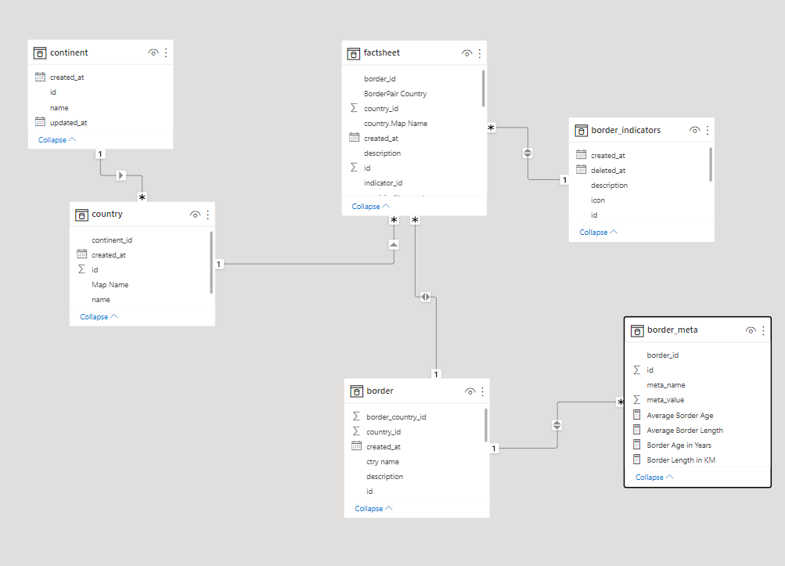
Database Schema Map
Africa Borderlands Centre
Continue

Slide 15
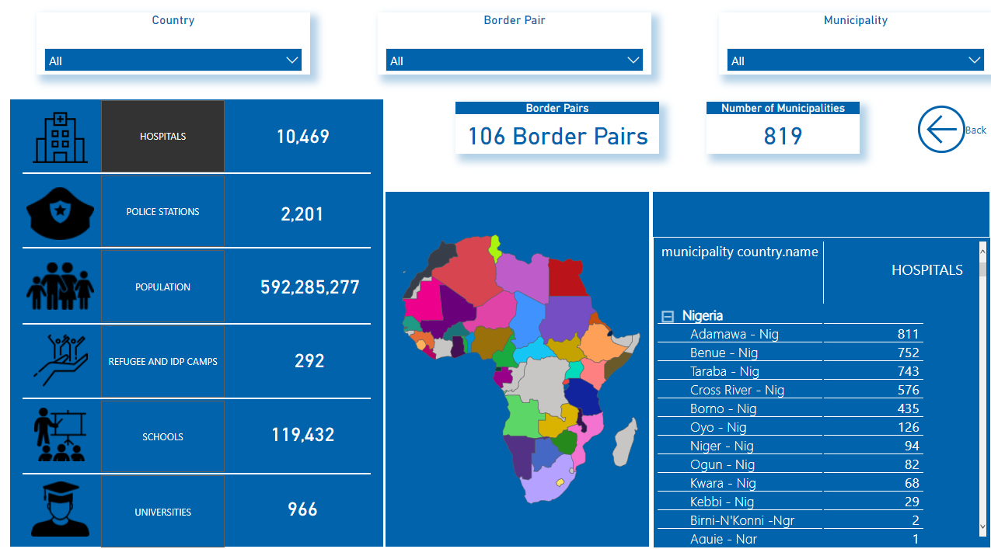
Drill Down Visualization & Navigation
Africa Borderlands Centre
Continue

Slide 16
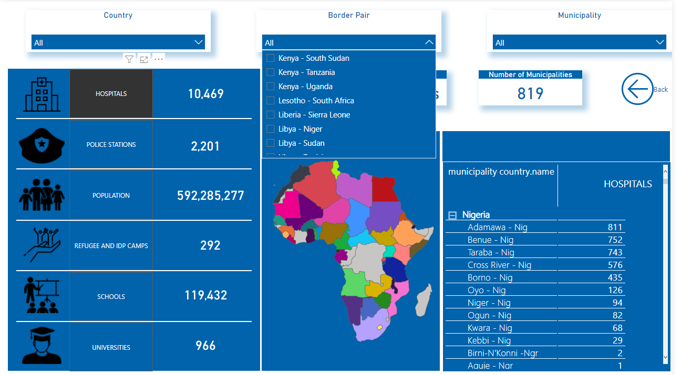
Filter Navigation – Click on Border Pair of Choice
Africa Borderlands Centre
Continue

Slide 17
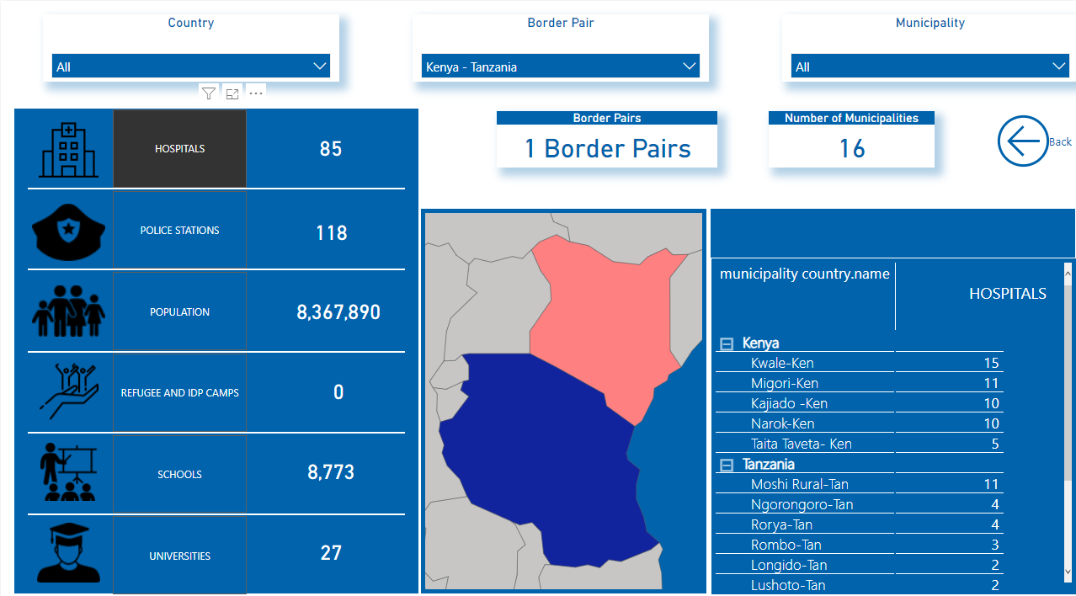
Select Indicator to Switch Municipality Coverage
Africa Borderlands Centre
Continue

Slide 18
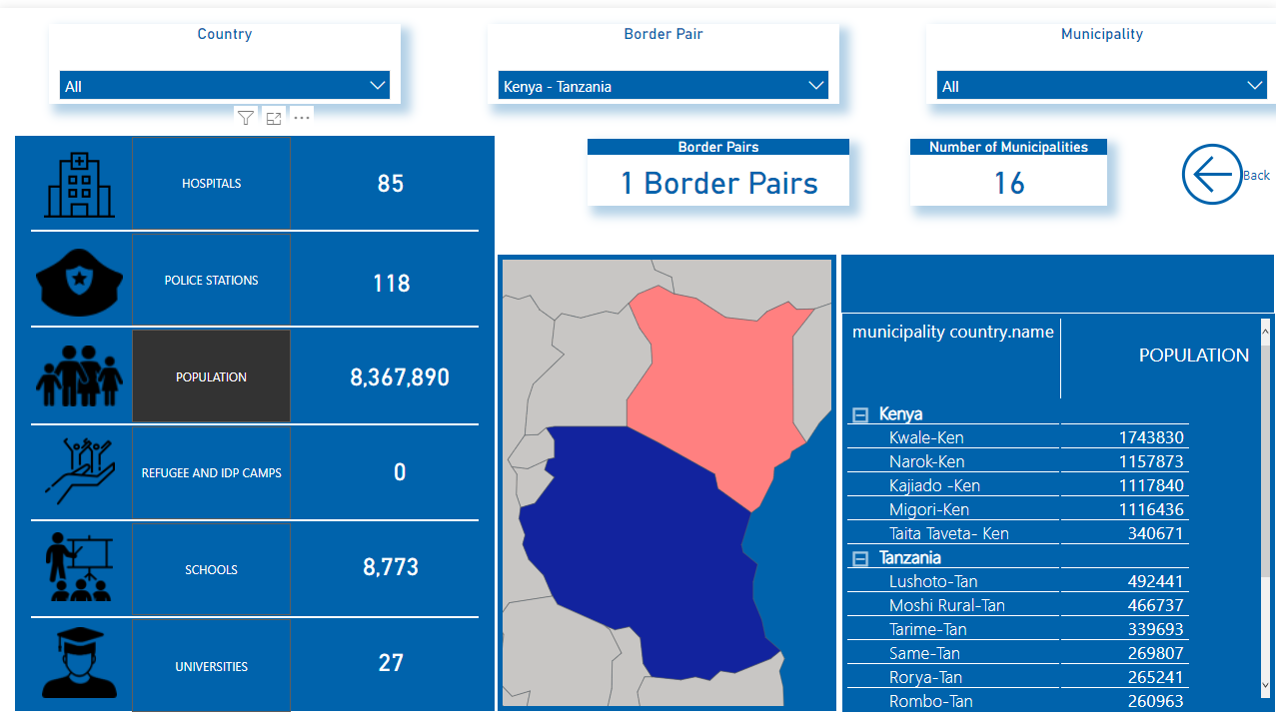
Indicator Change on Right Visual
Africa Borderlands Centre
Continue

Slide 19
Visuals Used
Africa Borderlands Centre
Note Visual highlighted in same color as description card
Vertical Filter
Data Card
Continue
Horizontal Filter
Matrix
Map

Slide 20
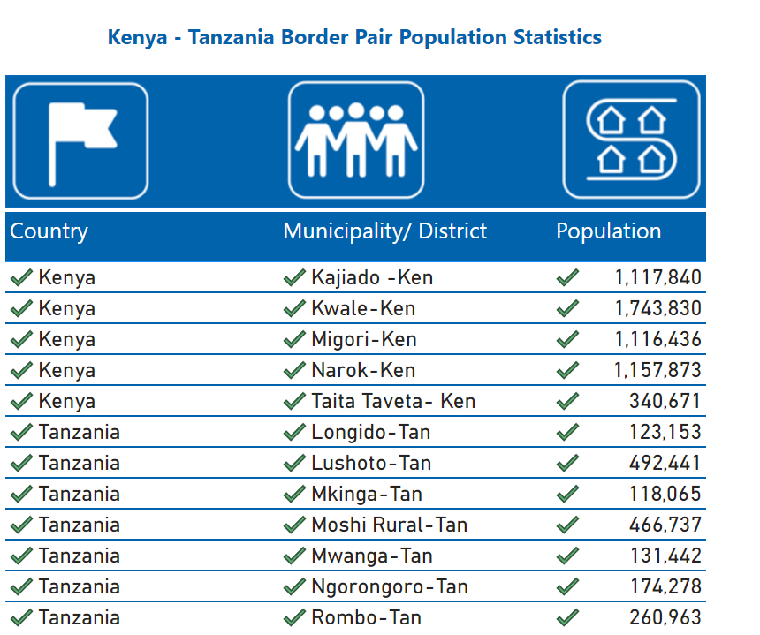
Table Visualization
Africa Borderlands Centre
Continue

Slide 21
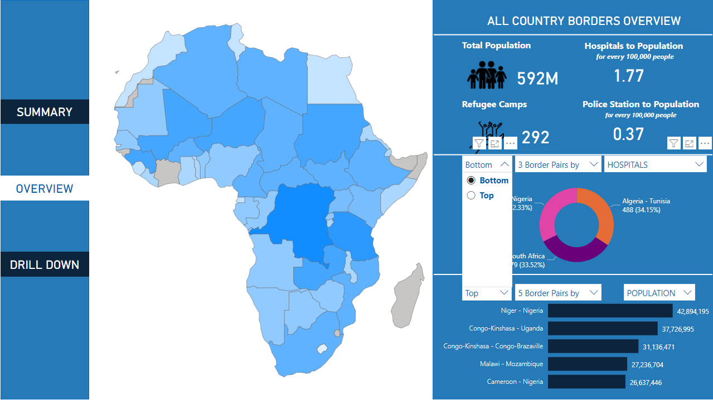
Dashboard Navigation Top/Bottom Filter
Africa Borderlands Centre
Continue

Slide 22
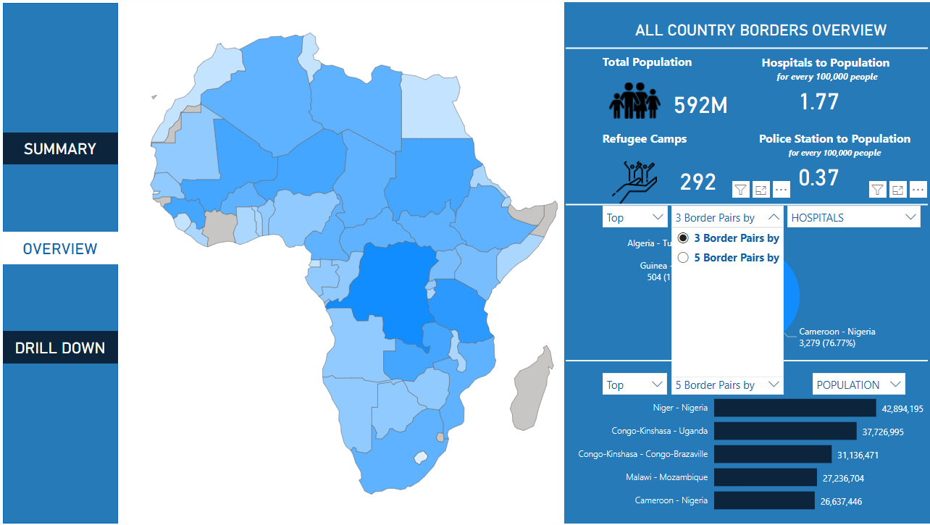
Dashboard Navigation Number Filter
Africa Borderlands Centre
Continue

Slide 23
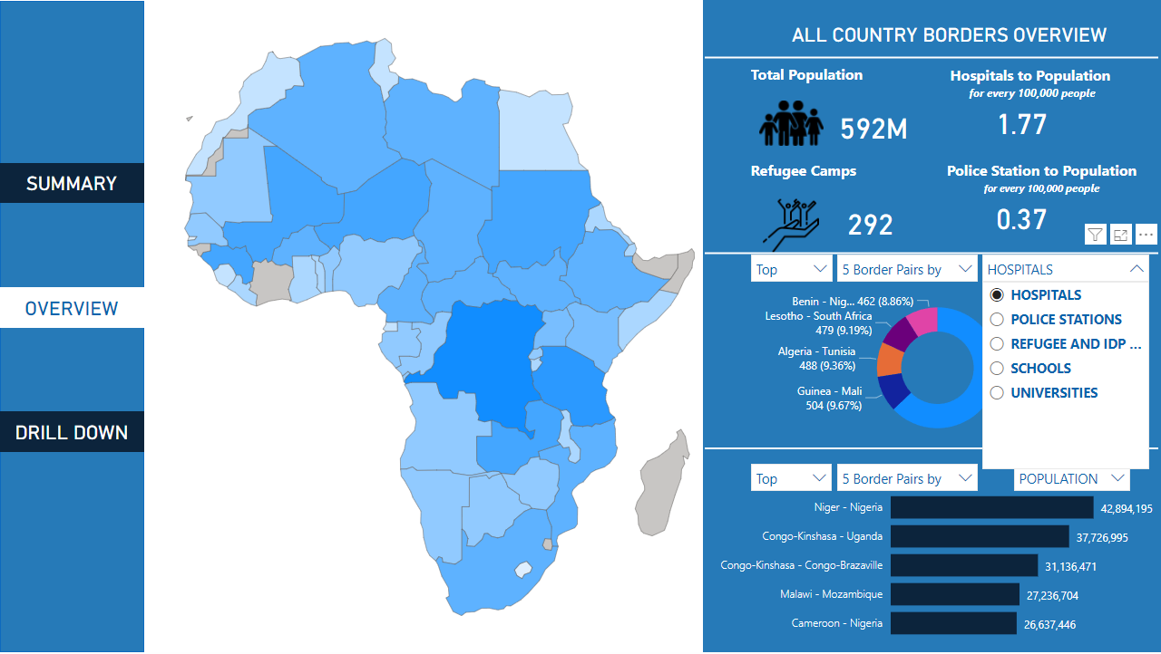
Dashboard Navigation Indicator Filter
Africa Borderlands Centre
Continue

Slide 24
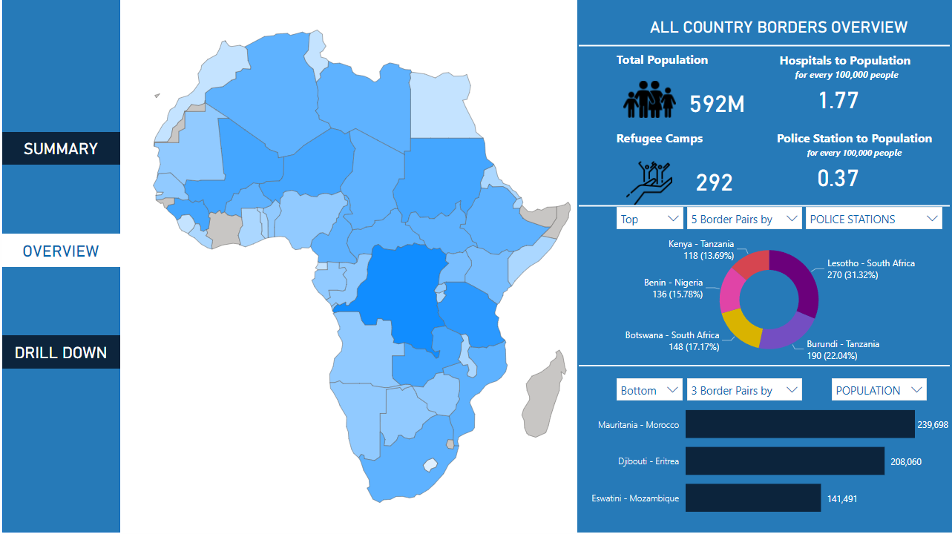
Dashboard Navigation Indicator Filter
Africa Borderlands Centre
Continue

Slide 25
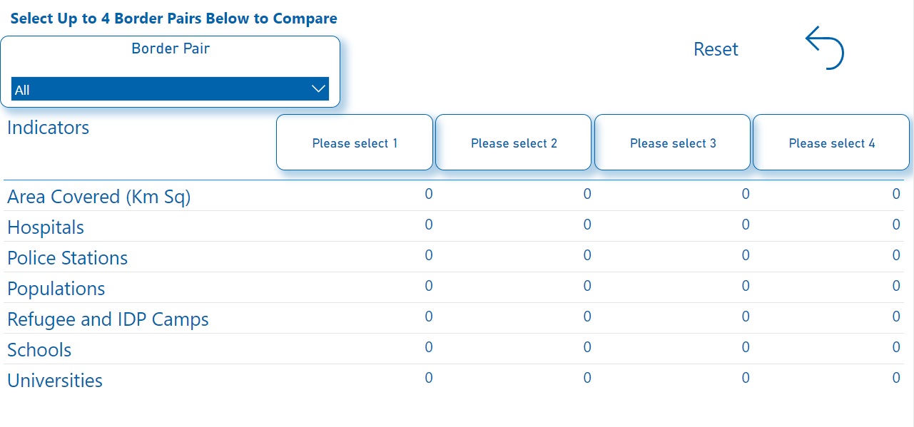
Border Pair Comparison Visual
Africa Borderlands Centre
Click the Drop Down to select border pairs to compare
Continue

Slide 26
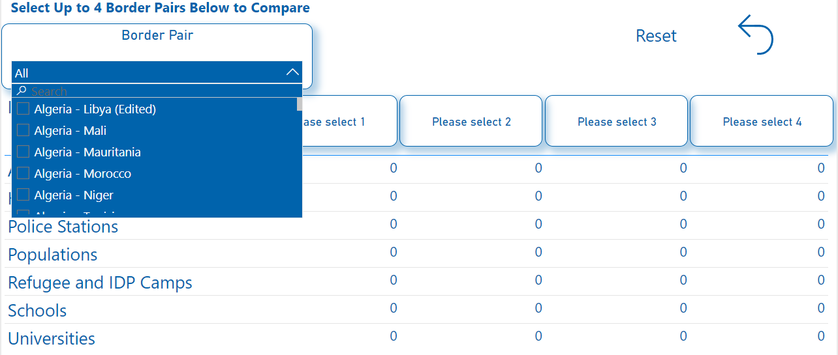
Border Pair Comparison Visual
Africa Borderlands Centre
Scroll to find border pair of choice
Continue

Slide 27
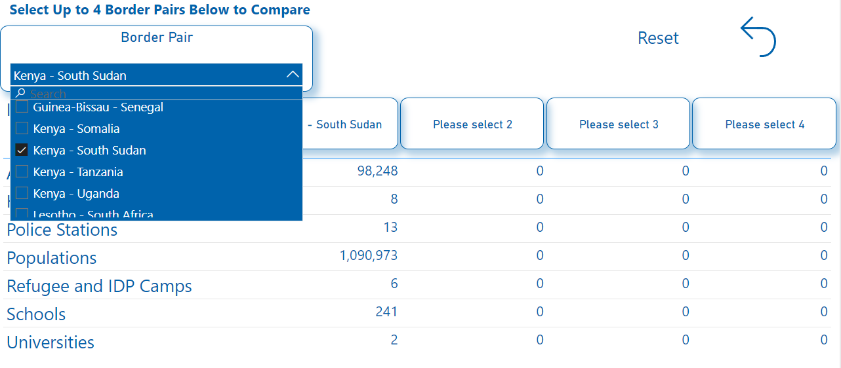
1 Border Pair Comparison
Africa Borderlands Centre
Continue

Slide 28
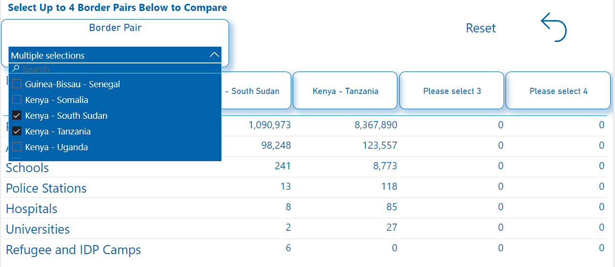
2 Border Pair Comparison Visual
Africa Borderlands Centre
Continue

Slide 29
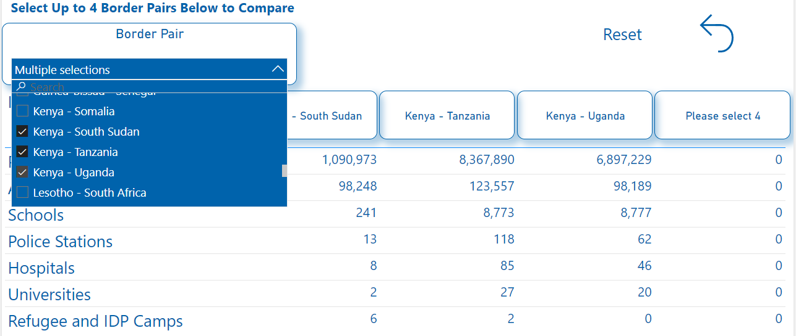
3 Border Pair Comparison Visual
Africa Borderlands Centre
Continue

Slide 30
4 Border Pair Comparison Visual
Africa Borderlands Centre
Continue

Slide 31
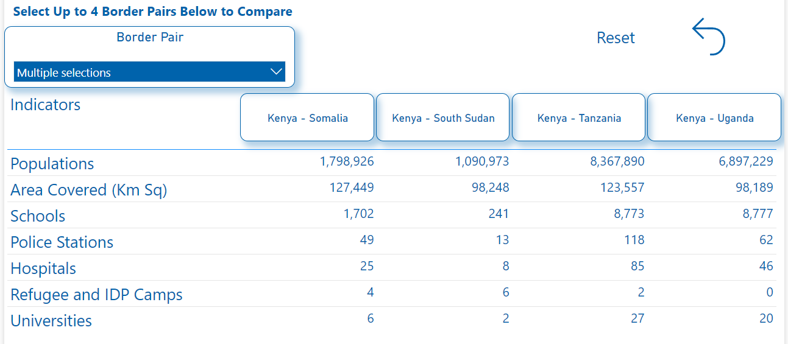
4 Border Pair Comparison Visual
Africa Borderlands Centre
Continue

